Slide 1
Staying Current with Legal Ethics in a Digital World
Referring Attorneys Seminar
November 5, 2021
Cliff Ruprecht
Roach Ruprecht Sanchez & Bischoff
Portland

Slide 2
Overview
Regulatory Environment – Rules and Opinions
Threat Environment – Risks and Pitfalls
Tips and Recommendations

Slide 3
Regulatory Environment
Ethics Opinions – Maine and ABA
Key Takeaways
Rules Recap

Slide 4
ABA Formal Op. 483 – Data Breach Response
https://www.americanbar.org/content/dam/aba/administrative/professional_responsibility/aba_formal_op_483.pdf
“law enforcement officials regularly divide business entities into two categories: those that have been hacked and those that will be”
Focuses on response following a data breach
Containment
Notification

Slide 5
Me. Op. 220 – Duties re Cyberattacks
https://www.mebaroverseers.org/attorney_services/opinion.html?id=1267989
Largely follows ABA No. 483 on response
But not entirely – former clients
Goes beyond Op. 483 – duty of prevention
Duty to use technology safely
Standard is reasonableness
Assess risks
Institute appropriate security
Keep it current
Update as risks evolve

Slide 6
Duty to Monitor
Op. 220 says you have a duty to understand the technology you use, implement adequate security and have “baseline competence”
You don’t have to be a tech expert
You do have to be capable of asking questions and getting reasonable assurances of the adequacy of safeguards

Slide 7
Duty to Monitor – Some Key Questions
The key issue is confidentiality of client information
For all your tech, be asking
How is the information secured against unauthorized access
In the ordinary course (password policies, access controls, encryption)
If something goes wrong (lost devices, intrusion into a network)
What can be done to detect unauthorized access
How can we assure uninterrupted access for ourselves (backup, disaster recovery)

Slide 8
Duty to Monitor – Areas of Concern
Computers, phones, tablets, etc.
Website
Payment systems
Network storage
Cloud or off-site storage (incl. flash drives, portable drives)
Email

Slide 9
Duty to Monitor – Some Basics
Devices should be protected with strong passwords
Have the ability to locate or remotely wipe or lockout any lost device
Software updates should be made routinely – this especially includes operating system updates
You should have secure backup, offsite, readily accessible in case of disaster (e.g. fire)

Slide 10
ABA Formal Op. 477R – Protecting Confidentiality When Communicating Over the Internet
https://www.americanbar.org/content/dam/aba/administrative/professional_responsibility/aba_formal_opinion_477.pdf
Duties of confidentiality are not greater or different based on the method of communication
But understand and manage the peculiar risks of each medium
The standard of care, again, is reasonableness
Express client requests control

Slide 11
ABA Formal Op. 477R – Reasonableness Factors
Sensitivity of the information
Likelihood of disclosure without the efforts
Cost of safeguards
Difficulty of implementing safeguards
Extent of adverse effects of safeguards on effective representation

Slide 12
ABA Formal Op. 477R – Key Recommendations
Understand the Threat
Understand How Information Is Transmitted and Stored
Adopt Reasonable Security Measures
Discuss with the Client
Label Confidential Information
Train Your Personnel (Lawyers and Non-Lawyers)
Do Due Diligence on Communication Technology Vendors

Slide 13
Opinions on Other Issues
ABA Op. 495 – Lawyers Working Remotely
https://www.americanbar.org/content/dam/aba/administrative/professional_responsibility/aba-formal-opinion-495.pdf
ABA Op. 498 – Virtual Practice
https://www.americanbar.org/content/dam/aba/administrative/professional_responsibility/aba-formal-opinion-498.pdf
ABA Op. 496 – Responding to Online Criticism
https://www.americanbar.org/content/dam/aba/administrative/professional_responsibility/aba-formal-opinion-496.pdf
ABA Op. 491 – Avoiding assisting in criminal or fraudulent transactions
https://www.americanbar.org/content/dam/aba/administrative/professional_responsibility/aba-formal-opinion-491.pdf

Slide 14
Rules Recap
Confidentiality 1.6
Safeguarding Property 1.15
Competence 1.1
Duty to Supervise 5.1 and 5.3
Respect for Rights of Others 4.4

Slide 15
Threat Environment
Inadvertent Disclosure
Hacking, Phishing and Scams
Clients Who Have Stuff They Shouldn’t

Slide 16
Inadvertent Disclosure – Getting by Mistake
Corey v. Norman Hanson & DeTroy, 1999 ME 196, 742 A.2d 933
Me. R. Prof. Cond. 4.4(b)
Stop Reading
Notify the Sender
Return, Destroy or Sequester

Slide 17
Inadvertent Disclosure – Sending by Mistake
Reply to All
Pause before you hit Send
Forward emails to clients rather than include them in a cc:
Auto-populate
Don’t trust the To: line
Spoofed Address
Don’t trust the From: line

Slide 18
Hacking and Phishing
Unauthorized Intrusion into a Computer System
Obtaining Information by Deceit Online

Slide 19
Hacking
Can be almost random or specially targeted
Prowling
War Driving
Port Scanning
Crypto mining
Targeted Access (may use phishing)
Law firms can be rich targets
Potentially high proportion of sensitive/valuable data
Trusted intermediary
Ransomware target

Slide 20
Phishing
Obtaining Information by Deceit Online
Email
Spoofed websites
Be Suspicious of Every Unexpected Email
Don’t Trust the From: line
Don’t Click Links

Slide 21
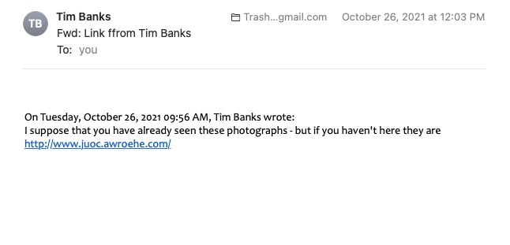

Slide 22
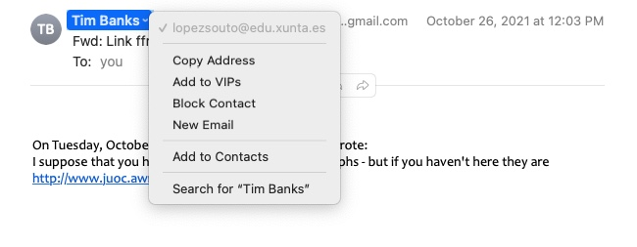

Slide 23
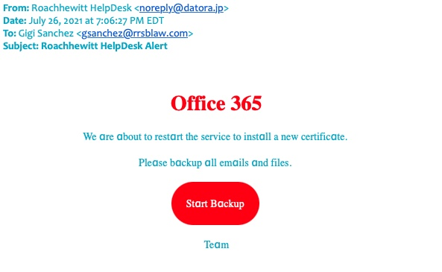

Slide 24
Phishing
Might look like your bank, Microsoft, your ISP, or other ordinary sources
Might link you to a website that pretends to be theirs
It might look like your client

Slide 25
Phishing
NEVER, NEVER, NEVER
Follow a link in an unexpected email (type the person’s website into your browser yourself)
Provide login information or other sensitive information to a website in a link you followed from an uncertain source
Respond directly to any suspicious email
When in doubt – call or email the sender to confirm
DON’T USE CONTACT INFORMATION FROM THE UNEXPECTED EMAIL

Slide 26
Law-Firm Related Scams
Trust Account Scam
Capitalizes on lag between ‘clearing’ funds and right to funds becoming final
Large deposit to your trust account
Fast resolution
Payout after funds in trust account have ’cleared’

Slide 27
Law-Firm Related Scams
Escrow Scam
Scammer poses as one or more of service providers as real-estate closing approaches (banker, real estate agent, lawyer)
Scammer persuades buyer to wire closing funds to fake escrow

Slide 28
Clients Who Have Stuff They Shouldn’t
Fiber Materials Inc. v. Subilia, 2009 ME 71, 974 A.2d 918
Bar Counsel Note 04/09/2013
Unrepresented beneficiary forwards PR emails between beneficiary and her former lawyer
Cannot read
Use a ‘taint team’
https://www.mebaroverseers.org/attorney_services/bar_notes.html?id=611882

Slide 29
Clients Who Have Stuff They Shouldn’t
Bar Counsel Note 04/09/2013
Unrepresented beneficiary forwards PR emails between beneficiary and her former lawyer
PR should not read
Use a ‘taint team’
https://www.mebaroverseers.org/attorney_services/bar_notes.html?id=611882

Slide 30
Clients Who Have Stuff They Shouldn’t
Divorcing Spouses
Shared Computer
Stolen Password
Employee Whistleblowers
Innocent/Anonymous Receipt

Slide 31
Tips and Recommendations

Slide 32
Things To Consider
Slow Down
Speed Is Often Not a Virtue

Slide 33
Things To Consider
Ongoing Discussion with Entire Team
Lawyers and Non-lawyers
Not “One and Done”

Slide 34
Things To Consider
Inform Clients
Alert them of risks
Tell them what you won’t ask them for by email
Encourage direct phone contact with you or your office

Slide 35
Things To Consider
Look at Your Insurance
Decide what cyber coverage you need
Make sure you are getting what you think you are

Slide 36
Things To Consider
Don’t Be Spooked by Technology
You Can Do This
Good judgment
Issue Spotting - Risk Management
Asking good questions

